Slide 1

UDP Peer to Peer Secure Data Transfer
Soumodipta Bose (2021201086)
Vishal Pawar (2021201025)
Mukul Kumar (2021201064)

Slide 2
UDP Peer to Peer Secure Data Transfer
The project aims to implement secure, high-speed peer-to-peer data transfer between two agents (Data Foundation and Partner) using NodeJS servers.
The transfer uses UDP for data transfer and TCP for transfer quality control.
The project involves creating Data Transfer Profiles for each agent, which include details
such as IP addresses, host names, and port details.
The data transfer is initiated by setting up a transfer request with parameters such as number of threads, IP addresses, and schedule time.
The project includes a web-based monitoring system to monitor the data transfer session.
The project involves integrating the Data Foundation with the file system and MinIO.

Slide 3
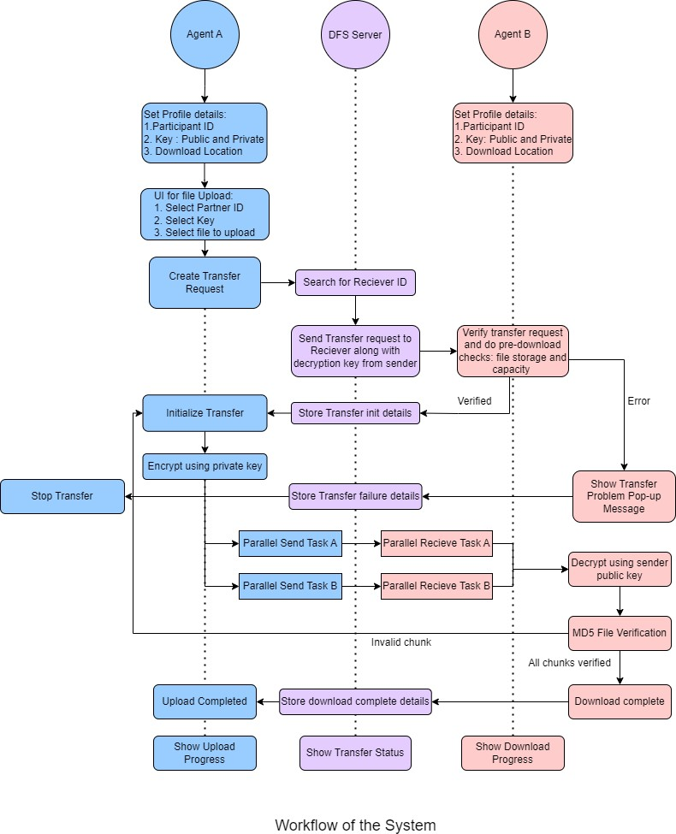
Proposed Solution

Slide 4
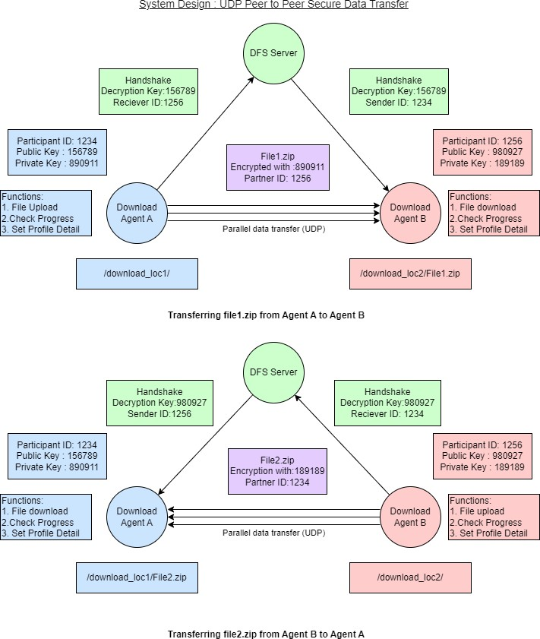
Proposed Solution

Slide 5

Work Done
Feature | Description | Notes | Ease of Deployment
Central Server(DFS server) | This is a central server that maintains a comprehensive list of institute IDs along with their corresponding IP addresses and secret keys. | The DFS server is equipped with various functionalities, such as maintaining a detailed history of all data transfers, managing institute list requests, monitoring ongoing data transfers, and acting as an intermediary between the sender and receiver during the transfer process. | Moderate
Sender | The sender will initiate the data transfer and perform a handshake process prior to the actual transfer. | The sender is equipped with multiple functionalities, such as initiating transfer requests, securing the communication through handshake and encryption mechanisms, monitoring the progress of the transfer, and viewing the comprehensive list of institutes maintained by the DFS server. | Moderate
Receiver | The receiver will receive the transfer request from the sender, and in response, perform a handshake process with the sender before proceeding with the data transfer | The receiver is equipped with several functionalities, such as accepting transfer requests from the sender, ensuring secure communication through the handshake and encryption mechanisms, monitoring the progress of the transfer, and accessing the list of institutes maintained by the DFS server. | Moderate
Handshake | Handshake is a validation mechanism that is established between the DFS server, sender, and receiver to ensure secure and authenticated communication before the actual data transfer takes place | The handshake process involves the sender and receiver logging into the system and retrieving the comprehensive list of institutes maintained by the DFS server. This process enables the sender to initiate transfer requests, which flow through the DFS server before reaching the intended receiver. | High
Data Transfer | Data transfer between sender and receiver is initiated by the sender after performing a handshake process with the receiver, and the progress of the transfer can be monitored through the transfer tabs. The transfer uses UDP for data transfer and TCP for quality control, and the DFS server maintains a list of institute IDs along with their corresponding IP addresses and secret keys for secure and authenticated communication. | After selecting a file or folder for transfer, it will be divided into multiple chunks and encrypted for secure data transfer. These encrypted chunks will be transferred in parallel to the receiver. Once all the chunks have been successfully received, theywill be decrypted and merged back into the original file or folder on the receiver's end. | High
Data Encryption | it is a crucial aspect of secure data transfer, and encryption mechanisms are in place to ensure that the data being transferred is secure and protected from unauthorized access. | The file or folder selected for transfer is encrypted to ensure that the data remains secure during the transfer process. The encryption ensures that the data remains protected from any unauthorized access, providing an additional layer of security to the transfer process. Once the data reaches the receiver's end, it is decrypted to restore it to its original format. | High

Slide 6

DFS Server
The DFS server will serve as a mediator between the
sender and receiver during file transfers.
The server will maintain a list of institutes containing their peer ID, IP address, and secret key.
Upon successful login, the sender and receiver can retrieve the institute list, which will be encrypted and can be decrypted using their respective secret keys.
The server will keep a record of all activities, including file
transfers and requests.
The server will also monitor ongoing transfers to ensure
that they are completed successfully.

Slide 7

Sender
Upon successful login, the sender can fetch the institute list from the DFS server.
The sender can initiate the transfer by selecting the receiver's ID from the list.
The sender uploads the file, and basic information such as UUID, filename, and file size are sent to the DFS server.
Upon initiation of the transfer, the request is forwarded to the receiver through the DFS server.
The sender can monitor and keep track of all downloads.
The transfer occurs in parallel chunks, and the data is encrypted before transmission.

Slide 8

Receiver
Once receiver login successfully it will fetch institute list from DFS Server
Receiver will receive transfer request from DFS server containing basic information like UUID, filename, File size and sender's information
Receiver can choose to accept or reject the transfer request
If the request is accepted, receiver's response will be sent back to DFS server, and file transfer will start
Receiver can monitor and keep track of all downloads happening
Data will be transferred in parallel chunks and encrypted before sending, and receiver will decrypt and merge the chunks after receiving all of them.

Slide 9

Data Transfer
The transfer process begins once the receiver accepts the request to download the file or folder.
The selected file or folder will be split into several smaller chunks for easier transfer.
Before sending, each chunk will be encrypted for added security.
The sender will transfer the chunks in parallel to ensure a
quicker transfer process.
On the receiver's side, multiple chunks will be received in parallel to speed up the download process.
Each chunk will be decrypted using the appropriate key on the receiver's side.
Once all chunks have been successfully decrypted, they will be merged back into the original file or folder.

Slide 10

Data Encryption
Data encryption is a crucial part of the transfer process, as it ensures that the information being transferred is secure and protected from unauthorized access.
When a file or folder is selected for transfer, it is divided into multiple chunks to facilitate parallel transfer.
Each chunk is encrypted before it is sent, using a secret key that is known only to the sender and receiver.
When the receiver receives the encrypted chunks, they are decrypted using the same secret key.
The decrypted chunks are then merged into the original file or folder, allowing the receiver to access the transferred data.

Slide 11
config
uuidv4
ip
express
ejslayouts
axios
session
passport
LocalStrategy
bcrypt
path
crypto
workerpool
mime
socket.io-stream
Main Library used in Node
JS

Slide 12
Install all library mention
Install nodemon
Start the DFS Server via: npm run devstart
Start Sender on any Computer via: npm run senderStart
Start Receiver on any Computer via: npm run receiverStart
Deployment
Before Starting Sender and Receiver DFS Server must be UP and running

Slide 13

Salient Features
Security : Login – Password is encrypted (Used bCrypt)
Login Authentication done using passport
File Upload – Socket Programming Using socket.io
Encryption – using Crypto library, used AES256 cbc
Parallel Processing
Implemented parallel downloading using Multithreading
Used worker pool
Thread pool reused

Slide 14
Salient Features
Fault Tolerant – using try catch
Lightweight – Express used for rest protocol
Memory Optimized – Used streams to read/write data instead of loading into memory
Persistent – used sqlite db
ORM mapper used for conerting classes to DB and vice versa – Using Sequalize
Backup of data (file) created incase of n/w failure.

Slide 15
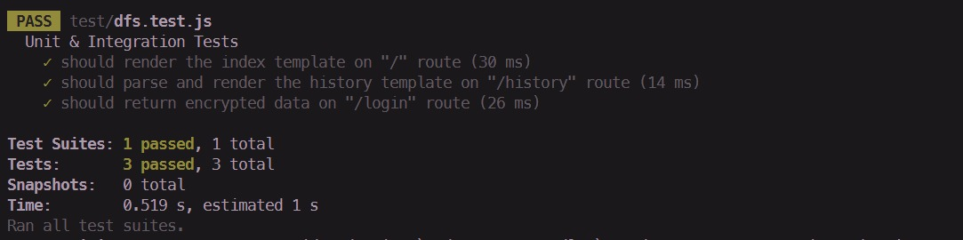
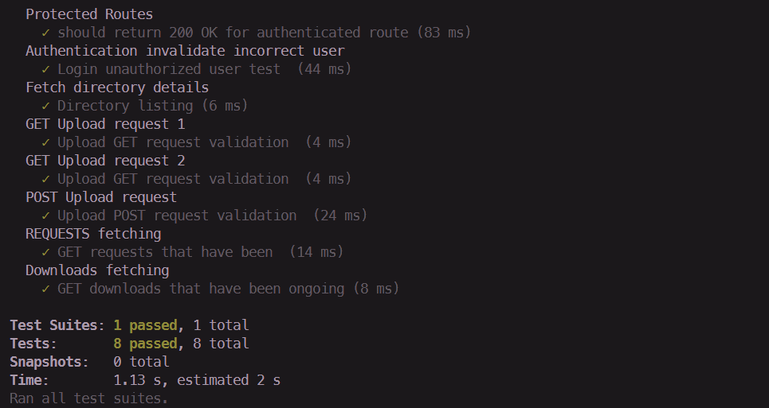
TESTING

Slide 16


